Slide 1
Review of BAUHINIA Project Business Application
Ryan Wickramaratne
ESOFT Metro Campus (Block E)
COL 00081762

Slide 2
Contents
Business Application Overview
Problem definition Statement
Proposed Solution Document
Proposed Tools, Techniques and Designs in Development
Development Strategy Document
Peer Review

Slide 3
Business Application Overview
Introduction to BAUHINIA Project
The BAUHINIA project aims to revolutionize the way BAUHINIA Clothing handles its business operations.
By moving from a social-media-based ordering system to a full-fledged online solution, BAUHINIA is set to improve customer engagement and streamline their inventory management.
The BAUHINIA Project is an initiative by AKL Software to address the operational challenges of BAUHINIA, a popular clothing brand in Sri Lanka.
Moving away from the constraints of social-media-based ordering, the project is an endeavor to leverage the power of agile software development and create an online solution.

Slide 4
The Need for the New Business Application
BAUHINIA is growing at a rapid pace, and the old approach of handling orders and managing inventory through social media networks is increasingly cumbersome.
There is a pressing need for a robust, user-friendly business application that can streamline various operational tasks, enhance customer engagement, and improve the overall efficiency of the business.
Primary Objectives of the Business Application
The new business application aims to automate BAUHINIA’s workflow and eliminate manual paperwork associated with inventory management.
The application seeks to provide an organized platform for tracking orders, managing inventory, creating daily and monthly reports, and improving overall business operations.

Slide 5
Who Will Use the Application?
The application is designed for various stakeholders within BAUHINIA's ecosystem.
It will be used by customers for browsing products, placing orders, and tracking their orders.
The staff, including the Production Manager, Inventory Handling Clerk, and Chief Accountant, will use the application for various operational and managerial tasks.

Slide 6
Key Features of the Application
Customer Registration and Sign-in: Customers can register and sign in to check product availability and place orders.
Product Browsing: Customers can browse the product catalog, check availability, and add products to their cart.
Order Placement and Tracking: Customers can check out products and track their orders. Payment will be made via cash on delivery.
Staff Registration and Sign-in: Staff can register and sign in to manage their tasks.
Daily Order and Product Availability Reports: Production Manager can generate daily reports on orders and product availability.
Inventory Management: Inventory handling Clerk can add new items to inventory and update existing item details.
Monthly Income Report: The Chief Accountant can generate monthly income reports.

Slide 7
Benefits of the Business Application
Improved Efficiency: By automating various operational tasks, the application will significantly reduce the manual workload and improve efficiency.
Enhanced Customer Engagement: The application will provide a user-friendly platform for customers to engage with BAUHINIA, leading to improved customer satisfaction and loyalty.
Streamlined Inventory Management: The application will make inventory management a breeze, reducing errors and ensuring optimal stock levels.
Technology and Security of the Business Application
The application will be built using cutting-edge technology to ensure smooth functionality, scalability, and a seamless user experience.
Emphasis will be placed on data security, with advanced encryption methods implemented to safeguard customer and business data.

Slide 8
Roles and Responsibilities within the Application
Different staff members will have different roles within the application. This includes creating and updating inventory records, generating daily orders and product availability reports, and creating monthly income reports.
Customers will have a secure, personalized space to browse products, place orders, and track their purchases.
Usability and Accessibility of the Application
The business application will be designed with a focus on usability and accessibility, ensuring that it provides a user-friendly experience for both staff members and customers.
It will be accessible across multiple devices, including smartphones, tablets, and computers, allowing users to engage with the application anytime, anywhere.

Slide 9
Future Scope of the Application
The business application is not a static solution but will be subject to continual improvements and updates to better serve the needs of BAUHINIA.
Future enhancements may include integration with other platforms, implementation of AI for demand forecasting, and adding new features based on user feedback and business requirements.
Summary of Business Application Overview
The BAUHINIA Project is a bold step forward in streamlining the business operations of the BAUHINIA clothing brand.
The new business application aims to address the brand's operational challenges, provide an enhanced shopping experience for customers, and create a more efficient and productive working environment for staff members.
This application represents an important part of BAUHINIA's digital transformation, with the potential to drive significant growth and success for the brand in the coming years.

Slide 10
Problem definition Statement
Problem Statement
BAUHINIA is struggling with inefficiencies in order processing and inventory management due to the manual nature of these processes.
Increased order volume from growing popularity has overwhelmed the current system.
The manual system is unscalable, time-consuming, labor-intensive, and prone to errors, leading to potential dissatisfaction and harm to BAUHINIA's reputation.

Slide 11
Impact of the Problem
Operational efficiency is compromised due to time and resource intensiveness of manual processes.
Human errors can lead to negative customer experiences and potentially damage brand reputation.
Lack of a seamless online ordering system can result in lost sales and decreased customer loyalty.
The current system poses challenges for staff, increasing their workload and potentially affecting their job satisfaction.

Slide 12
Limitations of the Current System
The main limitations of the current system include inefficiency and a high risk of errors. Manually managing each order, from receiving the request to arranging delivery, consumes significant time and effort, leading to inefficient use of resources.
The current system is inefficient, error-prone, and lacks real-time inventory data.
Poor scalability limits BAUHINIA's growth potential.
The absence of an effective online ordering system can negatively impact the customer experience.
Lack of automated reporting impedes monitoring of sales performance and informed decision-making.

Slide 13
Desired Outcomes from the New Solution
The new solution should improve operational efficiency, reduce errors, and provide real-time inventory tracking.
It should enhance scalability, customer experience, and enable automated reporting.
The system should also allow secure user registration and sign-in, with flexible access levels for staff members.
Risk Areas in Developing the New System
Potential risks include technical complexity, data migration issues, system security concerns, user acceptance, cost overruns, and dependency on the vendor.
These risks should be proactively managed to ensure the successful implementation of the new system.

Slide 14
Proposed Solution Document
Proposed Solution – Introduction
BAUHINIA Inventory Control Application aims to address the operational inefficiencies present in the current system.
The new system will include features like product browsing, product details, shopping cart, checkout process, order tracking for customers, and login, sign-up, reports, inventory update, and a dashboard for staff.

Slide 15
Limitations of the Existing System
Limited Accessibility: Customers must physically/order through social media visit the store for purchases, limiting reach.
Inefficient Inventory Management: The manual system may result in recording errors, stock mismanagement, and difficulties in tracking real-time inventory levels.
Limited Customer Reach: Operating solely social media based offline restricts the customer base to the local area.
Manual Record Keeping: Maintaining manual records can be time-consuming and prone to human errors. Analyzing data for insights is also challenging.
Lack of Data Analysis: Due to the absence of digitized and structured data, it's difficult to analyze sales trends, customer behavior, and inventory management.
Absence of Customer Profile: Without an online platform, BAUHINIA cannot create customer profiles for personalizing the shopping experience and improving customer loyalty.

Slide 16
Proposed System – Objectives
The goal is to transition BAUHINIA from an social media based offline manual system to an automated, online platform.
The proposed system will provide customers with the convenience of shopping from anywhere, at any time.
It aims to enhance the shopping experience, manage inventory efficiently, reach a broader customer base, and enable data-driven strategic business decisions.
Proposed System Analysis – Introduction
The proposed system for BAUHINIA is an e-commerce solution designed to transition BAUHINIA's current manual operations to an automated online platform.
The system aims to increase operational efficiency, expand customer reach, and enhance the shopping experience.

Slide 17
Proposed System – Key Features
The new system will include features like product browsing, product details, shopping cart, checkout process, order tracking for customers, and login, sign-up, reports, inventory update, and a dashboard for staff.
Customer Interface: Features like account creation, login, product browsing, product details, shopping cart, checkout, and order tracking will be available.
Staff Interface: Features like account creation, login, report generation, inventory updating, and a dashboard for an overview of business operations will be available.
Product Management: An extensive product database for easy management and updating by staff.
Shopping Cart and Checkout: A seamless and secure process for customers.
Order Management and Tracking: Efficient order management by staff and easy order tracking for customers.
Report Generation: Functionality to generate various reports for informed business decision-making.
Security and Compliance: Adherence to security standards and data protection laws to ensure safe transactions and protect customer data.

Slide 18
Benefits of the Proposed System
The proposed system aims to overcome the limitations of the existing system and provide a scalable solution to support BAUHINIA's business growth.
By transitioning to this system, BAUHINIA can enhance the shopping experience for its customers, manage operations more efficiently, and leverage data for strategic decision making.

Slide 19
Proposed Tools, Techniques and Designs in Development
Proposed Solution – Introduction
The project will be handled using Agile Scrum methodology, a collaborative and iterative approach to software development that allows for flexibility and rapid adjustments throughout the process.
Diagrams created for the project include ERD Diagram, Class Diagram, Use Case Diagram, Sequence Diagrams, User Interfaces Design, and Logical Database Diagram Design. These diagrams help to illustrate the system's design, its components, and how they interact.

Slide 20
Diagramming Tools
Microsoft Visio and Draw.io have been chosen as the primary diagramming tools for creating flowcharts, process diagrams, and other graphical representations needed in this project.
Programming Tools
PyCharm and Visual Studio Code, powerful and versatile Integrated Development Environments (IDEs), will be used for writing and testing the application's code.
Web Development Tool
Django, a high-level Python web framework, will be used to build the application. Django promotes rapid development and clean, pragmatic design, perfect for a project of this scale.

Slide 21
Configuration Management Tools
Git, a distributed version control system, will be used for source code management, enabling team members to work simultaneously without overwriting each other's changes.
Ansible, an open-source automation tool, will be used for deploying the application and managing its configuration.
Quality Assurance Tools
JUnit, a unit testing framework for the Java programming language, will help ensure the reliability and correctness of the new system's code.
Selenium, a tool for automating web browsers, will be used for testing the web application's functionality and ensuring it behaves as expected.

Slide 22
Documentation Tools
Microsoft Word and Confluence will be used for project documentation, recording everything from project requirements to test cases and results.
Markdown will be used for maintaining documentation alongside the codebase, making it easier to understand the code's purpose and functionality.
Design Tools
Figma and Adobe XD will be used to create the application's user interface and experience designs, helping to ensure the application is user-friendly and visually appealing.
Maintenance Tools
Jira, an issue and project tracking tool, and GitHub, a web-based hosting service for version control, will be used for tracking bugs, managing tasks, and maintaining the application's codebase.

Slide 23
Analysis Tools
Tableau, RapidMiner, and Google Analytics will be used for data analysis, helping the BAUHINIA team to understand their business better, make data-driven decisions, and improve their operations.
Process Modelling Tools
Bizagi and Microsoft Visio will be used for process modelling, helping to visualize the project's workflow and understand how different processes interconnect.
Prototyping Tools
Figma and Balsamiq will be used for creating functional prototypes of the application. These prototypes allow for user testing and feedback before the development phase.

Slide 24
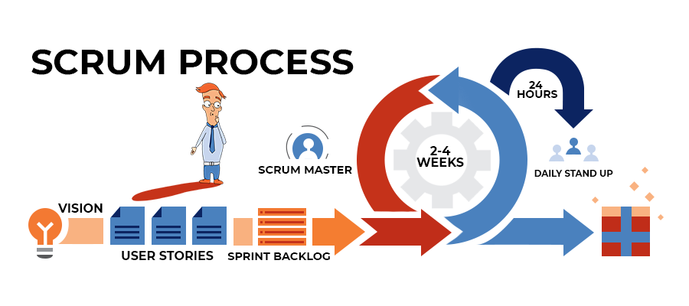
Development Technique
The Agile Scrum development technique has been selected for the BAUHINIA project. This method values flexibility, customer satisfaction, and collaborative problem solving, making it well-suited for a project of this nature.

Slide 25
Diagrams
A series of diagrams have been developed, including the ERD Diagram, Class Diagram, Use Case Diagram, Sequence Diagrams, and Logical Database Diagram Design. These diagrams will provide a visual representation of the application and its processes, aiding both development and understanding of the system.

Slide 26
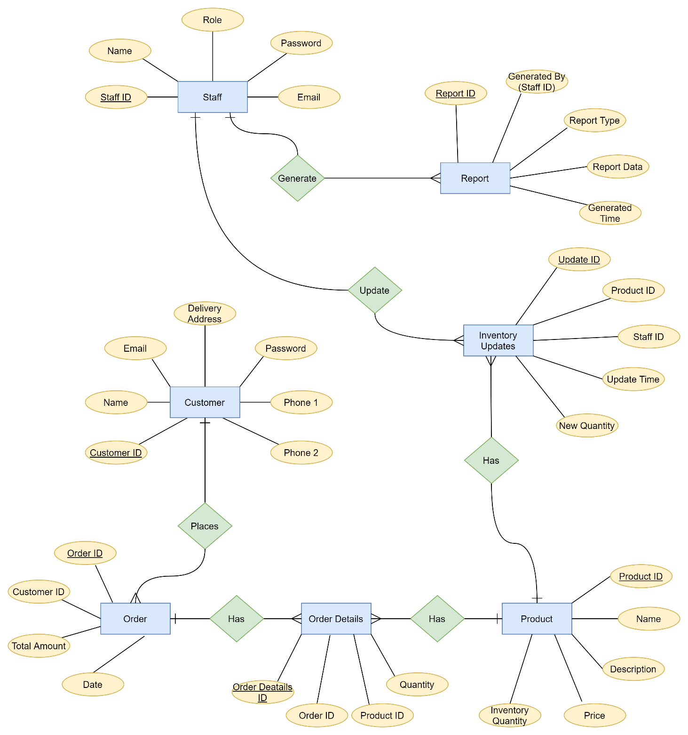
ERD Diagram

Slide 27
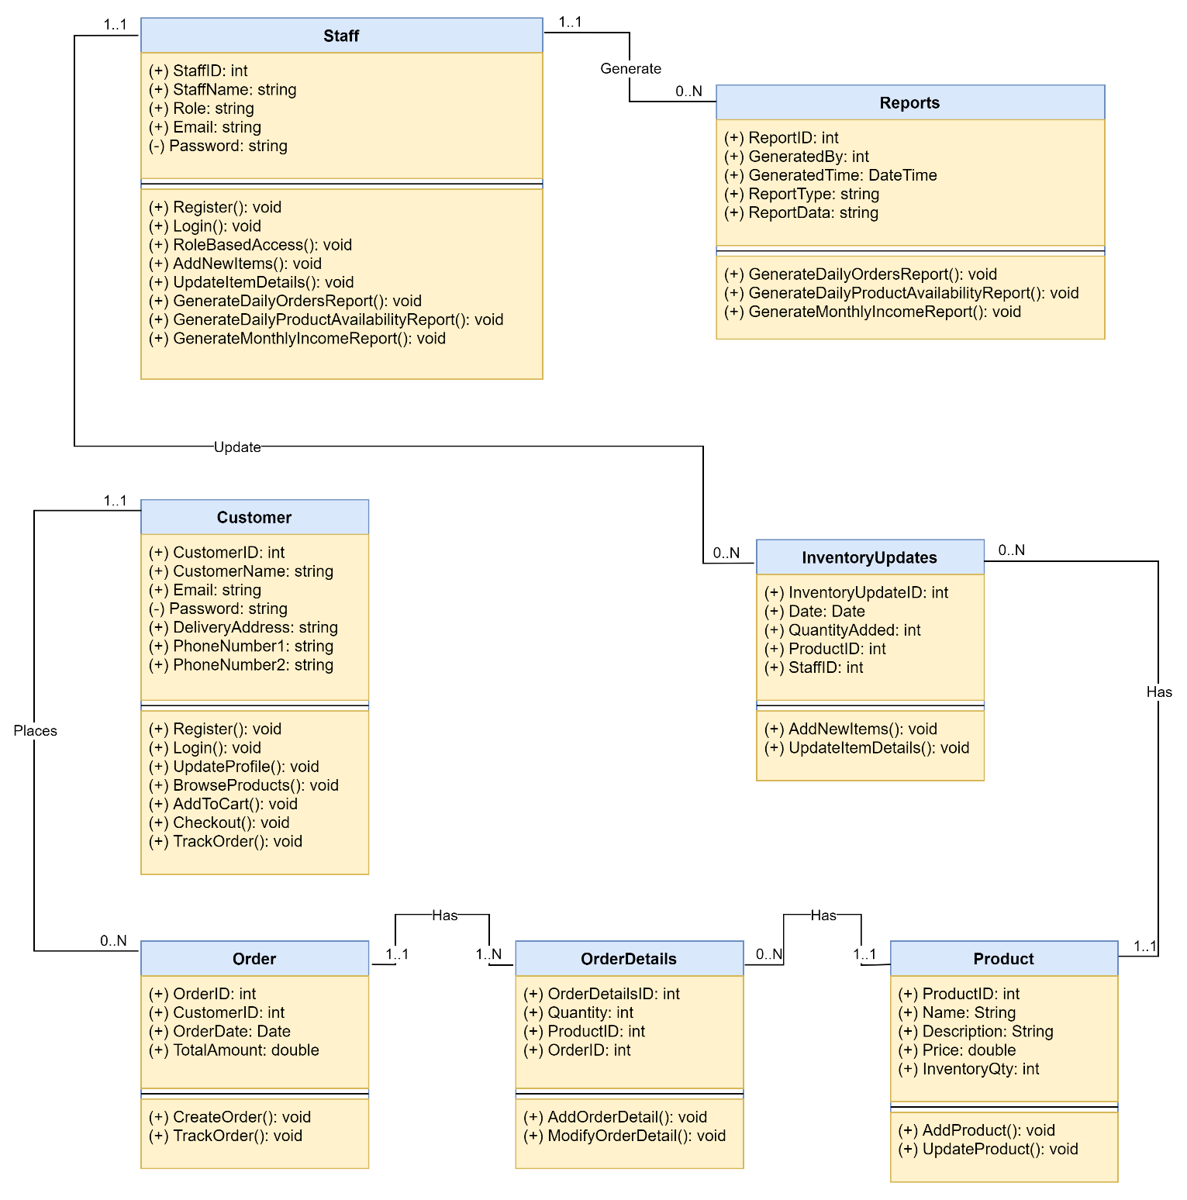
Class Diagram

Slide 28
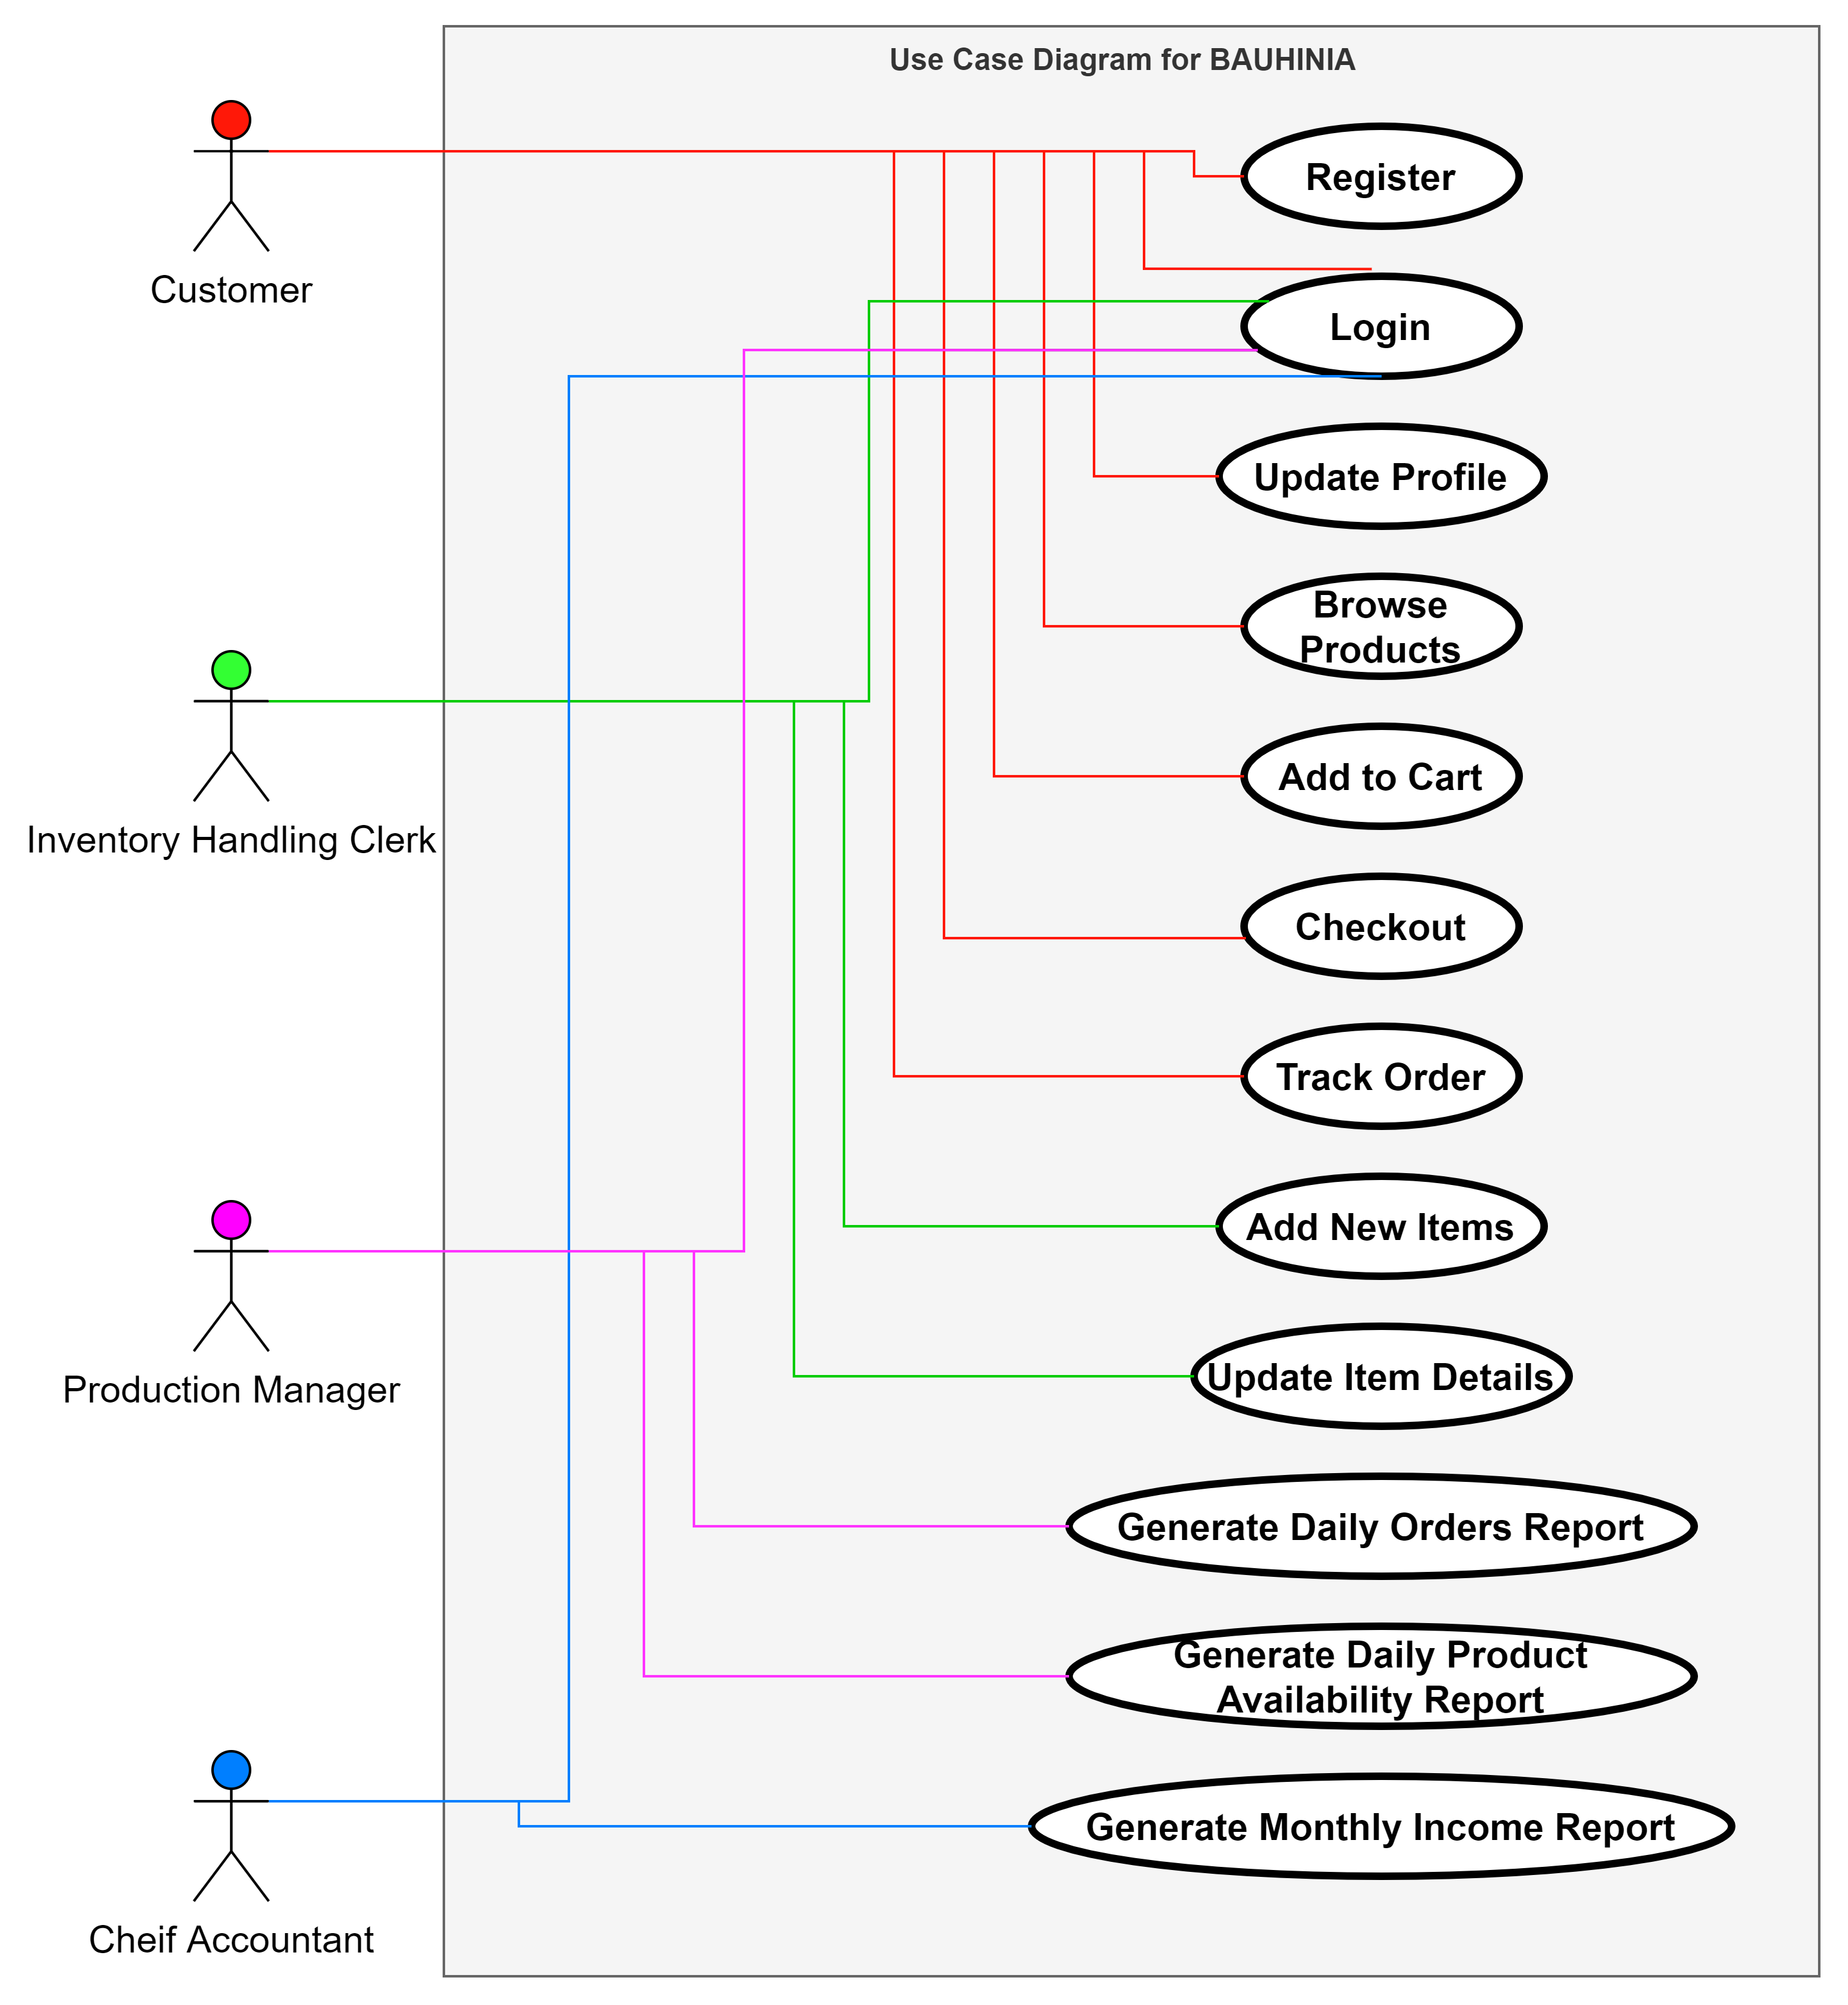
Use Case Diagram

Slide 29
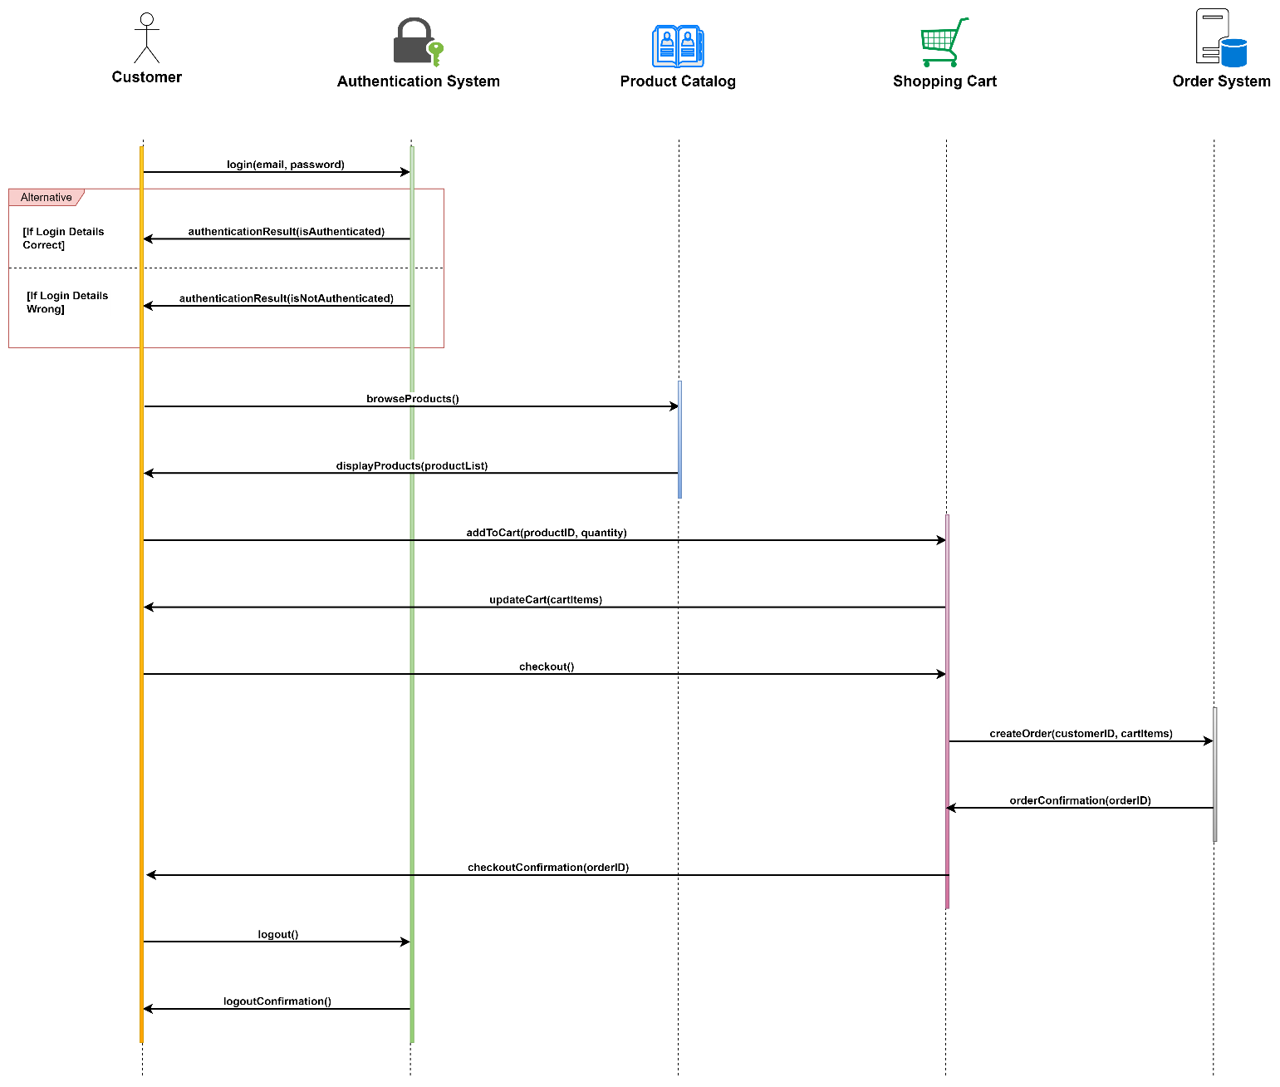
Sequence Diagram - 1
Customer Places an Order

Slide 30
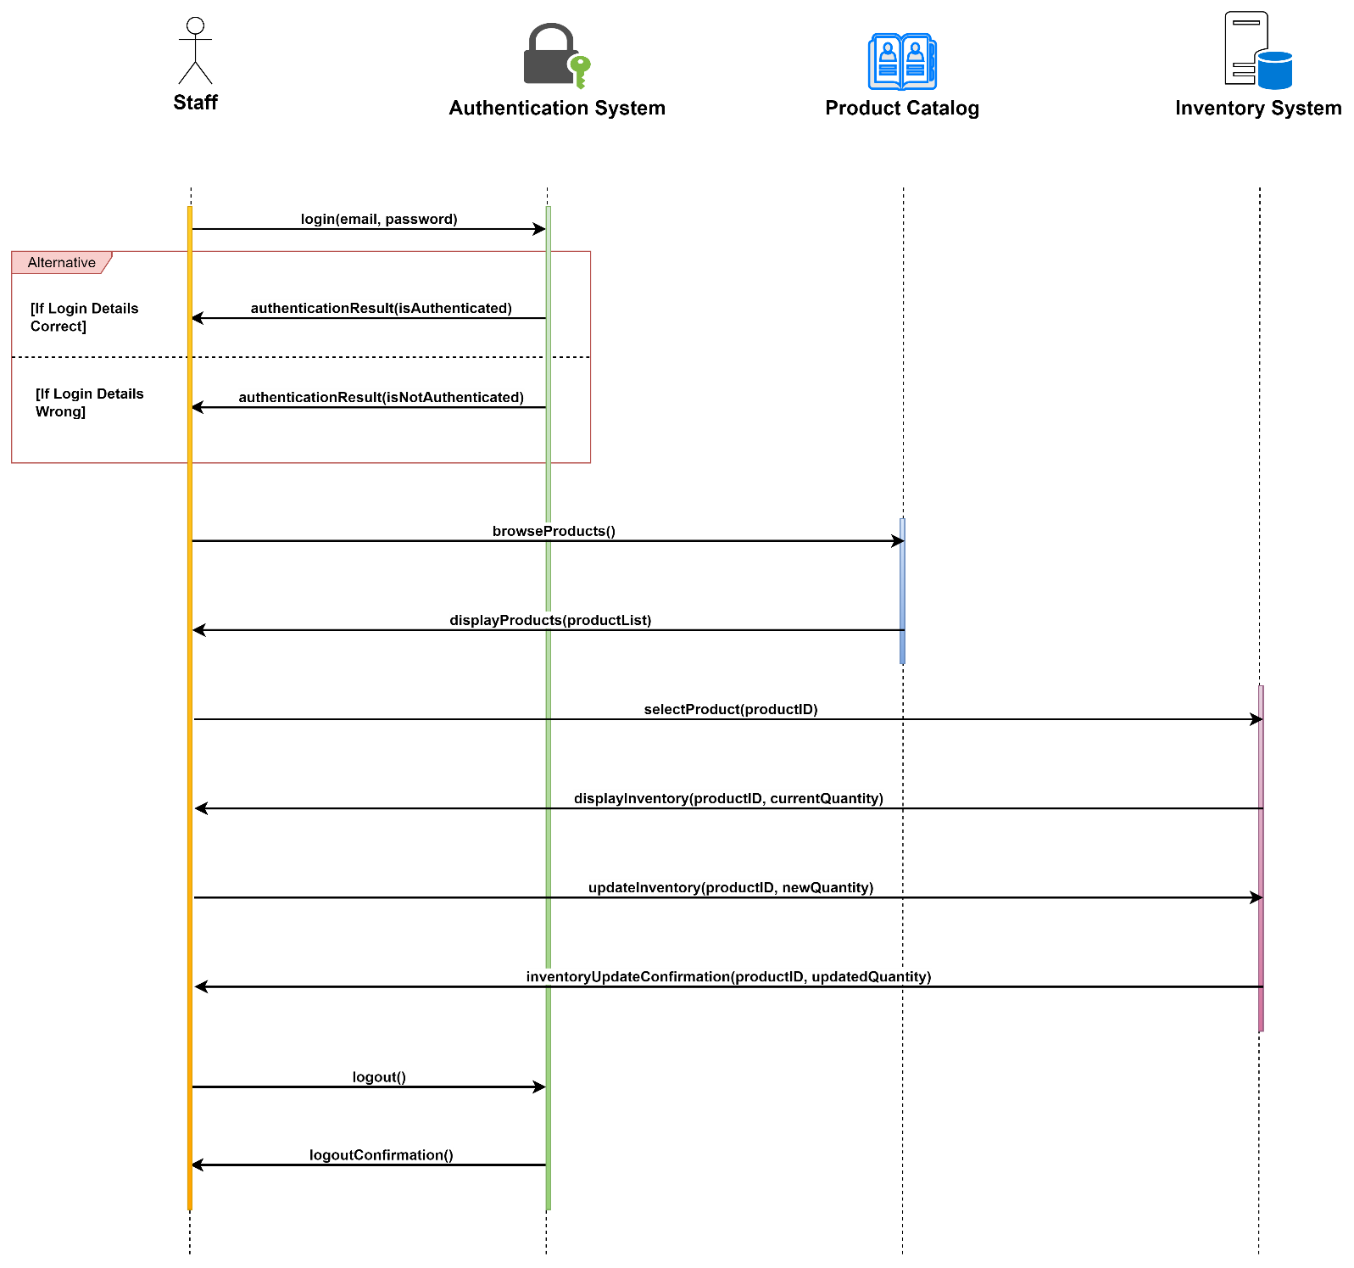
Sequence Diagram - 2
Staff Updates Inventory

Slide 31
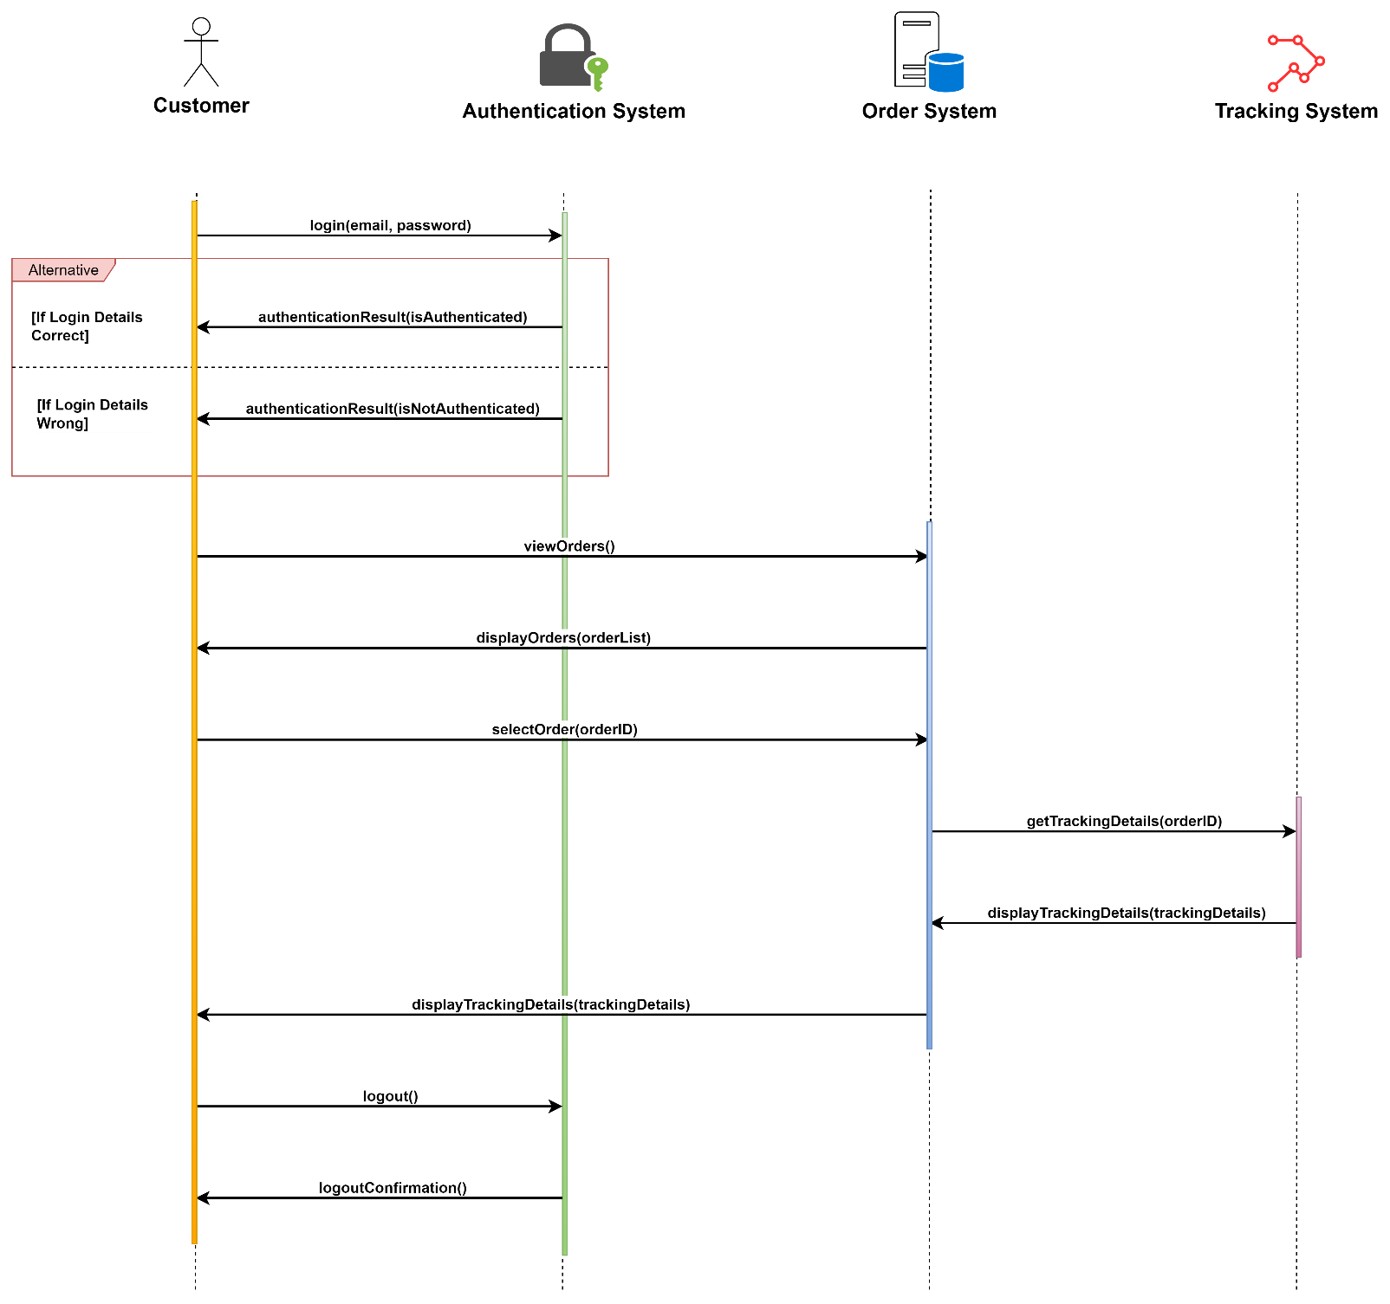
Sequence Diagram - 3
Customer Tracks an Order

Slide 32
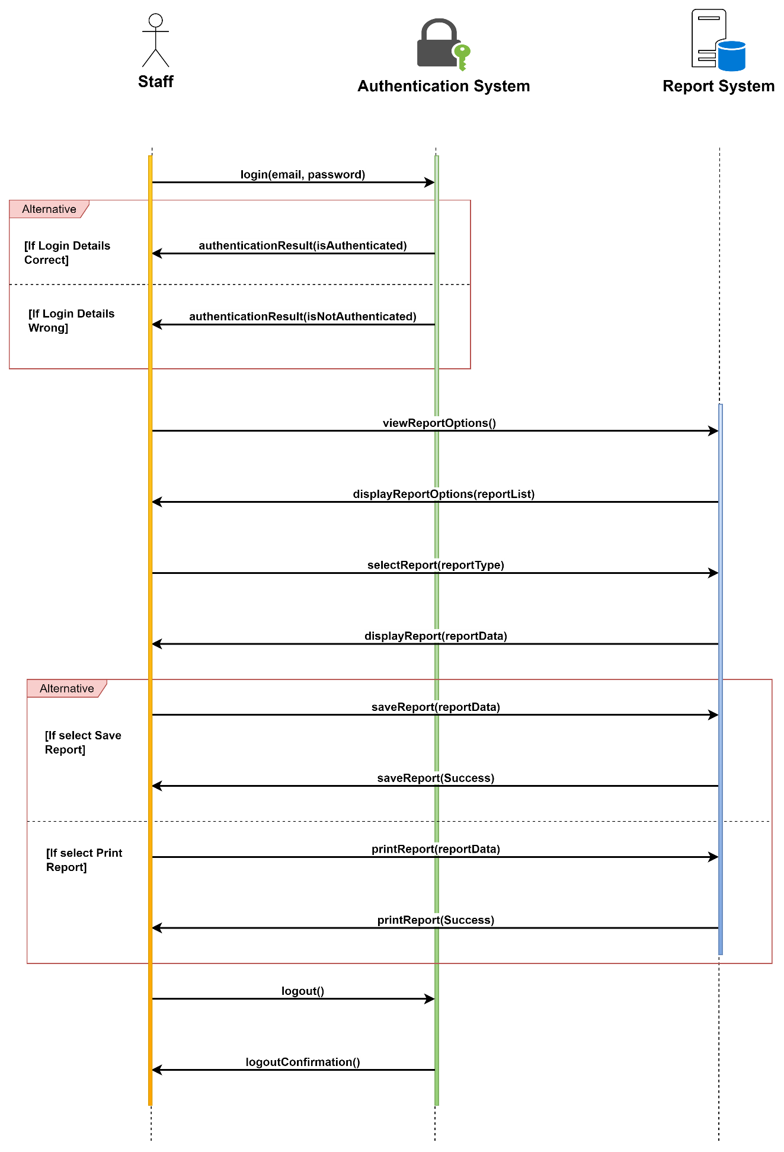
Sequence Diagram - 4
Staff Generates Report

Slide 33
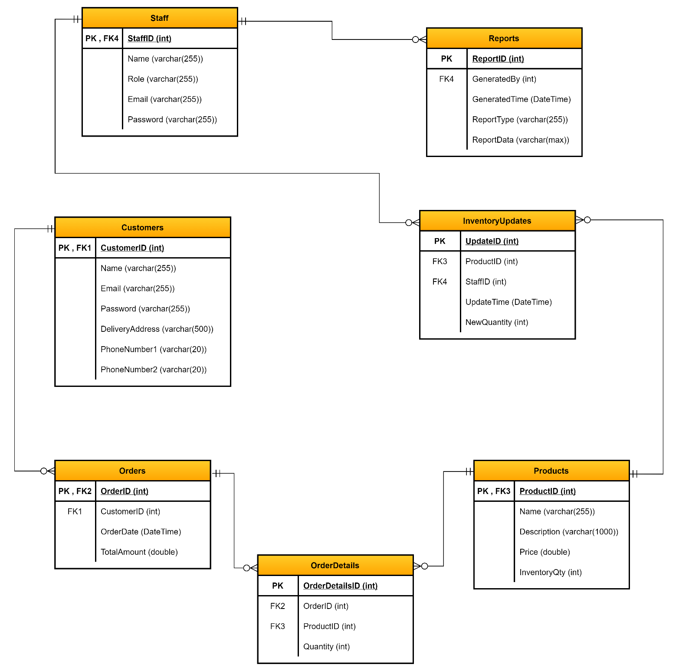
Logical Database Diagram Design

Slide 34
Development Strategy Document
Development Strategy – Introduction
Objective: Transition BAUHINIA from a manual, social media based offline system to an automated, online platform.
The proposed e-commerce solution is designed to enhance operational efficiency, expand customer reach, and improve the shopping experience.

Slide 35
Chosen Development Technique – Agile Scrum
Agile Scrum methodology has been selected for the BAUHINIA project to promote iterative progress, flexibility, and collaboration.
Key components: Sprint planning, daily stand-ups, sprint review, and sprint retrospective.
Agile Scrum enables continuous iteration of development and testing in the software development process.
This approach allows for flexibility and rapid response to changes, making it an ideal choice for this project.

Slide 36
Software Development Tools
Microsoft Visio and Draw.io: Used for creating diagrams to visualize system design and workflows.
PyCharm and Visual Studio Code: Selected as primary programming tools.
Django: Used for web development.
Git and Ansible: Employed for configuration management.
JUnit and Selenium: Chosen for quality assurance and testing.
Microsoft Word and Confluence, along with Markdown: Chosen for maintaining documentation.
Figma and Adobe XD: Design tools for creating appealing user interfaces.
Jira and GitHub: Utilized for project management and version control.
Tableau, RapidMiner, and Google Analytics: Selected as primary data analysis tools.
Bizagi and Microsoft Visio: Chosen for process modeling.
Figma and Balsamiq: Utilized for prototyping.
Jira and Git: Used for change control and issue tracking.

Slide 37
System Design
ERD Diagram: To visualize the structure of the database.
Class Diagram: To outline the structure of the system classes.
Use Case Diagram: To represent interactions between the system and its users.
Sequence Diagrams: To illustrate the flow of messages in the system.
User Interfaces Design: To ensure a user-friendly and intuitive application.
Logical Database Diagram Design: To detail the logical design of the database.

Slide 38
Collaboration and Communication
Regular stand-ups and review meetings will be conducted to ensure every team member is updated about the project status.
Jira will be used to assign tasks, track progress, and manage issues.
Confluence will serve as a common platform for documentation and knowledge sharing.
Testing and Quality Assurance
Regular code reviews will be conducted to maintain code quality.
JUnit will be used for unit testing, and Selenium for automated browser testing.
The system will be tested against the requirements to ensure it meets all defined criteria.

Slide 39
Deployment and Maintenance
Git will be used for version control, and Ansible for automating deployment processes.
The project will follow a continuous integration and continuous deployment (CI/CD) approach.
Post-deployment, Jira and GitHub will be used for tracking bugs and issues.
Risk Management
Identification: We will continually identify potential risks that may affect the project timeline, budget, or performance.
Assessment: We will evaluate the potential impact and probability of identified risks.
Mitigation: We will plan and implement strategies to mitigate these risks.
Review: We will monitor and review risks regularly, adjusting mitigation strategies as needed.

Slide 40
Training and User Adoption
Staff Training: A training program will be organized to familiarize the staff with the new system.
Customer Guidance: Tutorials and user guides will be provided to assist customers in navigating and using the platform effectively.
Feedback: A system for capturing user feedback will be established to understand any difficulties users may face and improve accordingly.
Performance Evaluation
Regular Performance Reviews: The performance of the new system will be reviewed regularly to ensure it meets business and user expectations.
Key Performance Indicators (KPIs): We will establish KPIs for system performance and monitor them regularly. This includes system uptime, page load speed, and transaction completion rates.
User Satisfaction: Regular surveys will be conducted to understand the level of user satisfaction and areas of improvement.

Slide 41
Scalability and Future Enhancements
Scalability: The system is designed to be scalable to accommodate future growth in business and user traffic.
Regular Updates: The system will be regularly updated to enhance features and improve security.
Future Enhancements: As BAUHINIA grows and evolves, the system will be updated to include new features and integrations, such as AI-driven recommendations, virtual fitting rooms, etc.

Slide 42
Conclusion
The development strategy for the BAUHINIA Inventory Control Application covers all aspects of the development process, from design and implementation to testing, deployment, and maintenance.
By following this strategy, we aim to deliver a high-quality, user-friendly, and efficient e-commerce solution that not only meets but exceeds BAUHINIA's business objectives.

Slide 43
Peer Review
Introduction to Peer Review
Purpose: Peer review is a crucial part of our development process, enabling us to obtain diverse insights and constructive feedback that contribute to a more refined and effective application.
Approach: Our peer review approach is systematic, thorough, and aims to ensure that every aspect of the project is critically examined.

Slide 44
Methodology of Peer Review
Selection: Peers were chosen based on their experience and domain knowledge.
Review Process: Peers independently reviewed the project and provided their inputs and suggestions.
Feedback Collection: Feedback from all peers was consolidated and analyzed.
Key Themes from Peer Review
User Interface: Some peers pointed out that the user interface could be made more intuitive for an enhanced user experience.
Additional Features: Suggestions were received for adding more analytics and reporting features for a deeper understanding of business operations.
System Integration: Feedback was received on integrating the application with other existing systems for a seamless operational experience.

Slide 45
Interpretation of Feedback and Identified Opportunities
User Interface: Improved UI could increase user satisfaction and interaction, potentially boosting overall productivity.
Additional Features: Introducing advanced analytics features could offer valuable data-driven insights, assisting BAUHINIA in strategic decision-making.
System Integration: Seamless integration with other systems can streamline processes and enhance operational efficiency.
Response to Feedback and Planned Implementation
User Interface: We plan to collaborate with our design team to work on the UI improvements based on the received feedback.
Additional Features: We intend to include the development of advanced analytics features in our upcoming development cycles.
System Integration: We are exploring possible ways to enable smoother integration with other systems as part of our ongoing development strategy.

Slide 46
Additional Feedback from Peer Review
Security Measures: There were suggestions for strengthening data security given the sensitive nature of the business data.
Scalability: With potential for business growth, peers emphasized the need for a scalable solution.
Mobile Compatibility: Making the platform mobile-friendly was another recommendation made by the peers.
Interpretation of Additional Feedback and Identified Opportunities
Security Measures: Enhancing data encryption and user authentication could significantly improve the overall security of the application.
Scalability: The application should be designed to accommodate increased traffic and growth, reinforcing its long-term utility.
Mobile Compatibility: A mobile-friendly design could extend the user base and improve user accessibility, offering a competitive edge.

Slide 47
Response to Additional Feedback and Planned Implementation
Security Measures: We will be investing in stronger data security measures to safeguard business data and user information.
Scalability: We will ensure that scalability considerations are incorporated into every stage of the development process.
Mobile Compatibility: We are exploring options to make the platform mobile-responsive without compromising on its functionality.
Conclusion
Valuable Insights: The peer review process has provided valuable insights that will contribute to the successful delivery of the BAUHINIA project.
Continuous Improvement: We perceive feedback not as criticisms, but as opportunities for improvement and innovation.
Future Reviews: We intend to conduct regular peer reviews to maintain the high quality of our work and stay aligned with best practices.

Slide 48

References and Q&A
References:
- Artin, M. (2011). Development Strategy (2nd ed.). Prentice Hall.
- Dummit, D. S., & Foote, R. M. (2004). Business Application (3rd ed.). Wiley.
Gallian, J. A. (2017). Problem Definition (9th ed.). Cengage Learning.
Q&A: Please feel free to ask any questions or share your thoughts about group theory and its applications in computer science.

Slide 49
THANK YOU

